Slide 1

P1: Intro to Processes (ABC 12.1)
Ion Mandoiu
Laurent Michel
Revised by M. Khan, J. Shi and W. Wei

Slide 2
Process Basics
A process is an instance of a program being executed
Core operating system (OS) concept
In a multiprocessing OS
Multiple programs can be executed at the same time
Multiple instances of a program can be executed at the same time
Executing multiple programs
Single-core: time-sharing
Multi-core: true parallelism + time-sharing

Slide 3
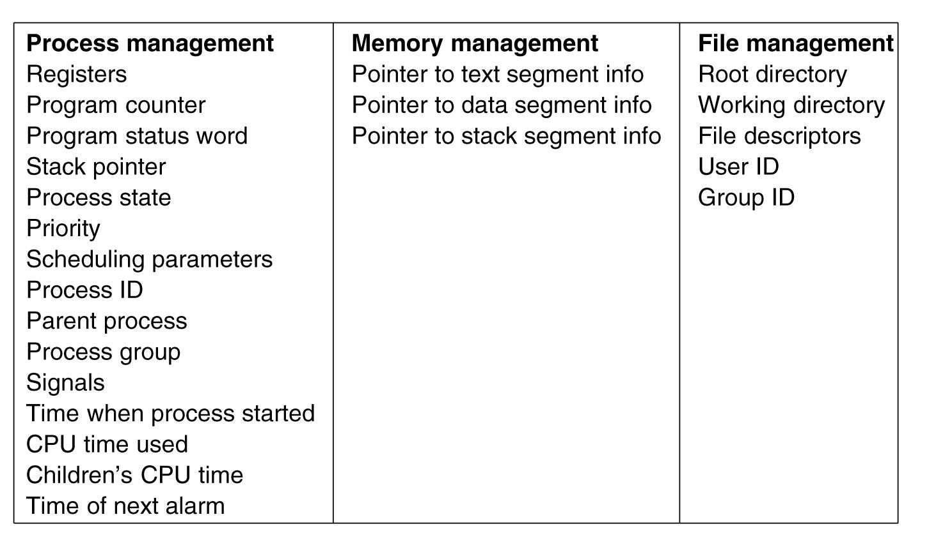
Process Management: OS View
OS maintains a process table
Each process has a table entry, called process control block (PCB)
Typical PCB info
OS scheduler picks processes to be executed at any given time
When a process is suspended, its state is saved in PCB
What about the process memory?

Slide 4
Paged Virtual Memory: How Processes Share Memory
HIGH
Page Tables
Physical memory is shared by all processes
Page table maps virtual address to physical address
Multiple virtual pages can be mapped to the same physical pages
Virtual address space 1
High
Physical
Memory
Low
Virtual address space 2
High
LOW
Low
Disk

Slide 5
Process Management: User’s View
Events which cause process creation
System initialization
User request to create a new process (e.g., shell command)
Executing a shell script, which may create many processes
Events which cause process termination
Normal program exit
Error exit
Fatal error, e.g., segmentation fault
Killed by user command or signal (Ctrl-C)

Slide 6
Useful Commands
ps
List running processes
pstree
Display the tree of processes
top
Dynamic view of memory & CPU usage + processes that use most resources (to exit top, press q)
kill
Kill a process given its process ID
Try -9 option if simple kill does not work
Additional functions/options in man page of each command
Notes:
kill –l lists all signals
9 happens to be SIGKILL

Slide 7
Process Management: Programmer’s View
Process birth
Processes are created by other processes!
A process always starts as a clone of its parent process
Then the process may upgrade itself to run a different executable
Child process retains access to the files open in the parent
Process life
Child process can create its own children processes
Process death
Eventually calls exit or abort to commit “suicide”
Or gets killed

Slide 8
Birth via Cloning
The function to create a new process in your code
#include <unistd.h>
pid_t fork(void);
Child is an exact copy of the parent
Both return from fork()
Only difference is the returned value
In the parent process:
fork() returns the process identifier of the child (> 0)
If a failure occurred, it returns -1 (and sets errno)
In the child process: fork() returns 0 (zero)

Slide 9
Concurrency
Parent and child processes return from fork() concurrently
They may return at the same time (on a multicore machine) or one after the other
Cannot assume that they return at the same time or which one “returns first” (even on a uni-core)
Order is chosen by OS scheduler

Slide 10
Cloning effect
On memory
The parent and child memory 100% identical
But are viewed as distinct by OS (“copy-on-write”)
Any memory change (stack/heap) affects only that copy
Thus the parent and child can quickly diverge
On files
All files open in the parent are accessible in the child!
I/O operations in either one move the file position indicator
In particular
stdin, stdout, and stderr of the parent are accessible in the child
Notes:
Any memory change (stack/heap/static) only affect the caller
Thus the parent and his clone can quickly diverge

Slide 11
What can the parent do ?
Depends on application!
It could wait until the child is done (dies!)
Typical of a shell like bash/ksh/zsh/csh/….
It could run concurrently and check back on the child later
It could run concurrently and ignore the child
If child dies it enters a zombie state

Slide 12
Waiting on a child
#include <sys/wait.h>
pid_t wait(int * status);
pid_t waitpid(pid_t pid, int * status, int options);
Purpose
Block the calling process until a child is terminated
Or other state changes specified by options
Report status in *status (which is ignored if NULL is passed)
The cause of death
The exit status of the child (what he returned from main)
Return value identifies the child process (or -1 on error)
Run “man -S2 wait” for full details
Notes:
Only on children, not grandchildren.

Slide 13


Zombies
A dead process, waiting to be 'reaped' (checked by its parent)
You cannot kill it, because it is already dead
Most resources released, but still uses an entry in the process table
Parents should check their kids
On some systems, parents can say they do not want to check
When a parent dies, ‘init’ becomes the new parent
Then the zombie child is reaped

Slide 14
System calls
APIs used to request services from the OS kernel
Example: fork()
System calls are more expensive than normal function calls
Manuals for system calls are in section 2
man -S2 intro ; man -S2 syscalls
system calls
program
OS
Notes:
execve is the system call form execl*
and execve()

Slide 15
Summary
Clone a process with fork()
The child is exactly the same as the parent
Check the return value
Parents wait for child processes
Reap the zombies!

